Slide 1
Internet Security (CI6240)
Week 7 – Hash Functions
(and Revision of DeterLab)
Dr Martin Tunnicliffe
M.J.Tunnicliffe@kingston.ac.uk
Dr Eckhard Pfluegel
E.Pfluegel@kingston.ac.uk

Slide 2
Teaching Block 1
Introduction
Mathematical Primer
Classical Cryptography
Digital Symmetric Ciphers
Public Key Cryptography
(Reading Week)
Cryptographic Hash Functions
Networks and Network-Based Attacks
Firewalls and Secure Architectures
Cryptography on the Internet
In-Class Test 1
TB1 Wrap-Up

Slide 3
Upcoming Workshop Schedule
Week Beginning | Workshop Topic
26 September | Introduction to Deterlab
3 October | Mathematics
10 October | Classical Ciphers
17 October | Simplified DES
24 October | The RSA Cipher Algorithm
31 October | (Reading Week – No Workshop)
7 November | Getting Started with DeterLab (Today’s Workshop)
14 November | TCP Syn Flooding Experiment *
21 November
28 November | Permissions and Firewalls Experiment *
5 December
12 December | Prize Cryptography Competition
(DeterLab exercises in red. Portfolio exercises shown with a *)

Slide 4
Material Covered
What is a Cryptographic Hash Function?
Types of Hash Algorithm
  MD5
  SHA
Summary of Hash Function Uses
Hash Functions and Passwords
Message digests/digital signatures
“Proof-of-work”
Revision of DeterLab

Slide 5
1.
What is a Cryptographic Hash Function?

Slide 6
Hash Functions
It is a Deterministic Function:
  It always produces the same output for the same input
Input is an arbitrary length string
Output is a fixed-length string
MESSAGE
(Arbitrary Length)
HASH FUNCTION
HASH
(Fixed Length)
Nice day, today!
8aff6b316dfd9bb9b3ced8cecfc9ce91163584cd6cd611702959c79dac2295d0

Slide 7
Properties of a Hash Function
Three crucial properties:
  Collision Resistance: the chance that two inputs produce the same output should be extremely small
  Preimage Resistance: it should be infeasible to determine what input produced a given output
  Fast! (But not too fast – see later!)
Output seems to be random
  But is actually not random at all but deterministic
Any change in input creates a large change in output
  Avalanche property (as in block ciphers)

Slide 8
Properties of Hash Functions
Mixing-transformation:
  Output computationally indistinguishable from a uniform random binary stream
Practical efficiency:
  Computation of h can be done rapidly
Collision resistance
  Likelihood of finding x,y with x ≠ y such that h(x)=h(y) should be small
Pre-image resistance:
  Given x´, it should be computationally infeasible to find x such that h(x) = x´.

Slide 9
Cryptanalysis of Hashes
Preimage attack:
  Given x´, find x such that h(x) = x´
  Can be done using brute force search (2^{L} attempts, where L=digest size in bits)
  Internet search (for published hashes)
  More specialised methods (e,g. “rainbow tables”)
Second preimage attack:
  Given x, find y such that h(x) = h(y)
Collision attack:
  Find x,y with x ≠ y such that h(x)=h(y)
  Requires on average only 2^{L/2} attempts
  Brute force still not very practical

Slide 10
2.
Types of Hash Algorithm

Slide 11
Common Hash Algorithms
MD5 (128 bit digest)
  Developed by Ronald Rivest in 1991
  Weaknesses discovered from 1996 onwards
  Is still used somewhat, but is not recommended for very secure systems: has been shown to have weaknesses
SHA-1 (160 bit digest)
  Developed by US National Security Agency (NSA) in 1995
  Weaknesses discovered 2005 onwards
SHA-3 (224+ bit digest, depending on version)
  Realeased by NIST in 2015

Slide 12
The MD-5 Hash Algorithm
We will use MD-5 as an example of a hash function
  It is good enough for our pedagogic purposes
  Remember not to use it for anything important when you are out in industry – research the best hash algorithms available to you then. (The landscape changes fast!)
Try it out at http://www.md5hashgenerator.com/
  Input text “The cat sat on the mat”
    Hash output: 4fbcb31ac4eb0dc150a5b9095cb6a85b
  Input text: “The cat sat on the mat.”
    Hash output: eb46e86d8c31e68274676127c0ce1365

Slide 13
3.
Uses of Hash Functions

Slide 14
Typical Uses
As a Check Sum
  A hash is calculated for a file when it is made/sent/stored
  When a user receives the file, he/she recalculates the hash and compares it with the original value
  If there is any difference then the file must have been corrupted or tampered with (it may contain a virus!)
For Passwords
  When a user chooses a password, the system hashes the password and stores the hash
  When user enters password, this is hashed and compared with stored hash
  If attacker retrieves hash from database he cannot use it to log in

Slide 15
Typical Uses
Digital Signatures
  The hash of a message can be digitally signed instead of message itself – greater efficiency
Proof-of-Work
  A Proof-of-Work (PoW) puzzle is a cryptographic problem which requires a party to expend computing power to solve.
  A user can be required to solve such a problem before they can access some restricted service (e.g. logging in).
    Used in the BitCoin algorithm to restrict the generation rate of new bitcoins by bitcoin “miners”.

Slide 16
4.
Hash Functions and Passwords

Slide 17
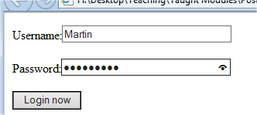
Hash Functions for Passwords
Simple Login System:
  User chooses a password when he/she creates account
  System stores that password in a database
  When user logs in, the system compares the password he/she enters with the stored value
http://staffnet.kingston.ac.uk/~ku12881/Internet_Security/Password_Management/

Slide 18
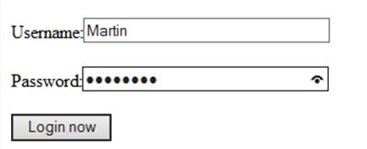
Password Management System: Try #1
WEB
CLIENT
Martin
potatoes
potatoes
HTTPS Request (Martin, potatoes)
WEB SERVER
DATABASE SERVER
MySQL Request
Martin
potatoes
SELECT * FROM accounts WHERE Username=“Martin”
Table: accounts
Username | Password
Martin | potatoes
James | zombies
Compare
Response Table
Username | Password
Martin | potatoes
Notes:
Although the password can travel between hosts in a TLS connection, the server where the passwords are stored might be compromised. Anyone who accesses the “accounts” table can log into any account.

Slide 19
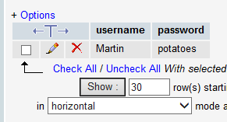
How Secure Is This System?
Attacker breaks into the database server
Reads the password
Logs in as the user!

Slide 20
Try #2: Password Hashing
WEB
CLIENT
“Martin”
“potatoes”
“potatoes”
HTTPS Request (Martin, potatoes)
WEB SERVER
DATABASE SERVER
MySQL Request
Martin
potatoes
SELECT * FROM accounts WHERE Username=“Martin”
HASH FUNCTION
Table: accounts
Username | Password
Martin | 125AB23F…
James | ACD32FE…
Compare
Response Table
Username | Password
Martin | 125AB23F..

Slide 21
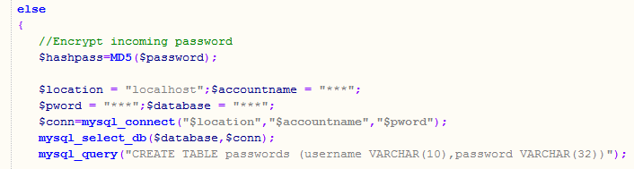
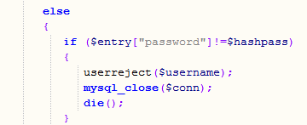
Password Hashing
$hashpass holds the hashed password
MD5 hashes are 32 characters
Retrieved password compared with $hashpass
Notes:
Although password hashes are now stored, it is possible to reverse these hashes if the passwords themselves are weak. We can overcome this problem using “salting”.

Slide 22
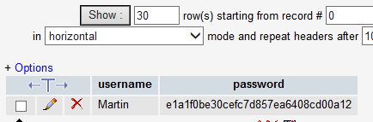
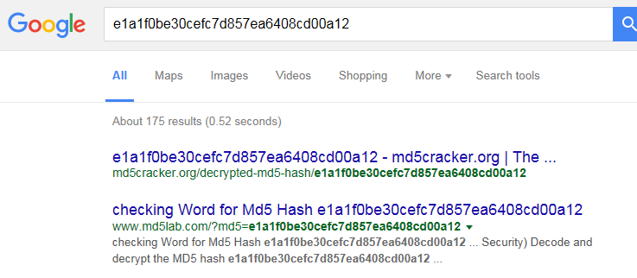
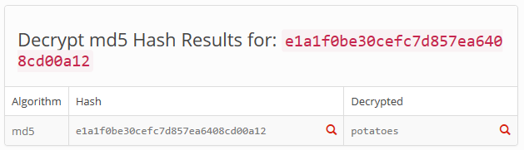
How Secure Is This Now?
Attacker breaks into the database server…
Attacker Googles the hash…
WASN’T VERY DIFFICULT, WAS IT?

Slide 23
Try #3: “Salting” Passwords
Password Creation
Chosen Password “potatoes”
Password
Verification
Offered
Password “potatoes”
Random Salt “356”
||
HASH FUNCTION
||
HASH FUNCTION
Compare
Table: accounts
Username | Password | Salt
Martin | 125AB23F… | 356
James | ACD32FE… | 332
Username | Password | Salt
Martin | 125AB23F.. | 356
Response Table
Database

Slide 24

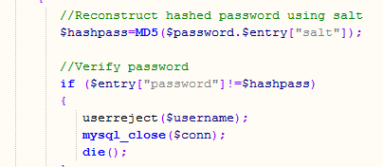
“Salting” Passwords
Three Digit Random Number
Salt and password catenated to make $hashpass
Salt and hashed password both stored in database
Salt retrieved from database “catenated” with offered password and hashed
Reconstructed password hash compared with retrieved version

Slide 25
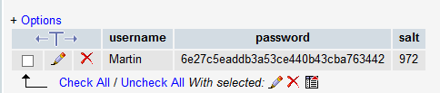
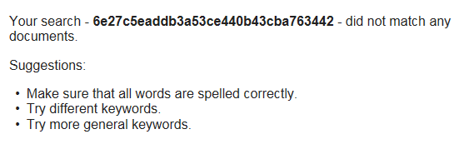
How Secure Is It Now?
As before, attacker penetrates database…
But when he/she Googles the hash:
No one ever thought to publish the MD5 hash of “potatoes972”!

Slide 26
5.
Message Digests and Digital Signatures

Slide 27


Use for Digital Signatures
“Digital Signing”
“Signature Verification”
Public key B
Private key B
Private key A
Encrypts
Decrypts
Public key A
Alice
Bob
Message
Sent
Message
Received
This does not make the messages secure but it proves the messages are uncorrupted and authentic
If received message is anything other than gibberish it must have come from Alice and cannot have been altered: AUTHENTICATION PLUS INTEGRITY
BUT HOW DOES A COMPUTER KNOW?

Slide 28

The Hash Function as a Check Sum
Sender
Insecure
Channel
Receiver
Plaintext Message
“Plaintext Message”
CORRUPTION
Hash Function
Hash Function
“Message Digest 1”
=?
“Message Digest 2”
COMPARE TO VALIDATE!
Notes:
If the message digests don’t match then one of two things has happened; either the sender is not genuine (authentication problem), or else the message or digest (or both) have been altered in transit (integrity problem).

Slide 29
But…
What if it is read by a machine which can’t tell “sense” from “nonsense”?
What if transferring unstructured binary data, e.g. from a sensor?
  Sense and nonsense might superficially look very similar!
What if message is very long?
  Double encryption might take a long time!
Solution: use “hash functions”

Slide 30

Use for Digital Signatures
Sender
Insecure
Channel
Receiver
Plaintext Message
“Plaintext Message”
Hash Function
Digital Signature
Sender’s Public Key
Hash Function
Harry
Message Digest
Encryption
Function
Decryption
Function
Digital “Signing”
“Message Digest 1”
“Message Digest 2”
Sender’s Private Key
=?
COMPARE TO VALIDATE!
Notes:
If the message digests don’t match then one of two things has happened; either the sender is not genuine (authentication problem), or else the message or digest (or both) have been altered in transit (integrity problem).

Slide 31
Adding Confidentiality…
Receiver’s Public Key
Receiver’s Private Key
Sender
Insecure
Channel
Receiver
Plaintext Message
Encryption
Function
Decryption
Function
“Plaintext Message”
Hash Function
Digital Signature
Sender’s Public Key
Hash Function
Harry
Message Digest
Encryption
Function
Decryption
Function
Sender’s Private Key
“Message Digest 1”
=?
“Message Digest 2”
Notes:
The digital signature could of course be concatenated with plaintext and encrypted/decrypted along with it.

Slide 32
6.
“Proof of Work”

Slide 33
What is “Proof-of-Work”
It is sometimes helpful to make a user of an Internet service “pay” for it by performing “work”.
Examples:
  Bitcoin miners must perform work to add transaction records to the “block chain” and claim rewards.
  Users logging into a system bight be made to “work” to submit their password (to prevent them doing a “brute force” attack

Slide 34
Proof-of-Work (PoW) Problem
“Challenge” String
“Response” String
Generate response string
Around 2^{x}
iterations
Hash Function
Add challenge string
No
Required output:
000…..00XXXXX…..XX
Perform hash function
Correct Output?
x consecutive 0’s
(X can be 1 or 0)
Yes
Verify
Forces the challenged party to “do work” – if x=40, he/she must perform about 2⁴⁰=1,000,000,000,000 hashing operations.
Imposes a “cost” on the challenged party, deterring him/her from over-using/ abusing services (if proof-of-work needed before access given).

Slide 35
Proof-of-Work (PoW) Verification
“Response” string
Add challenge string
“Correct” output:
000…..00XXXXX…..XX
Perform hash function
Correct Output?
No
Yes
Verified
Not Verified
Only one hashing operation is needed to check that this work has been done.

Slide 36
7.
Revision of DeterLab

Slide 37




DeterLab Architecture
Experiment Testbed
Control Network
SSH
Your PC
Control Server
users.deterlab.net
Virtual Network
This time you will create a simple network of multiple virtual nodes, and make them exchange traffic.

Slide 38
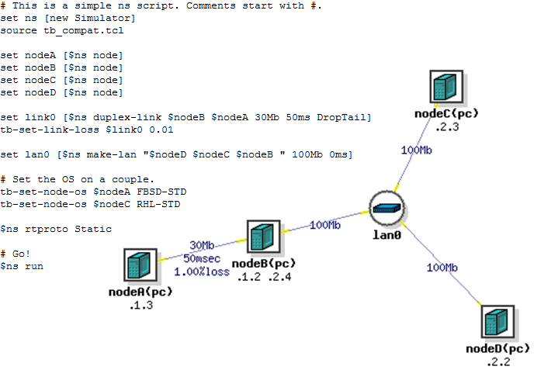
Today’s Workshop
Web Client
Web Server

Slide 39
Summary
What is a Cryptographic Hash Function?
Types of Hash Algorithm
  MD5
  SHA
Summary of Hash Function Uses
Hash Functions and Passwords
Message digests/digital signatures
“Proof-of-work”
Revision of DeterLab

Slide 40
Homework
Do the online quiz and the set homework exercise.
Next time we will look at the structure of the Internet and the kinds of attack to which it is vulnerable:
  Watch the following you-tube videos:
    https://www.youtube.com/watch?v=9hIQjrMHTv4
    https://www.youtube.com/watch?v=wqzKvTg3uIw
    https://www.youtube.com/watch?v=nZqwfLef-CM
  Check out the following web pages:
    http://www.nato.int/docu/review/2013/cyber/timeline/EN/index.htm
    http://www.bbc.co.uk/news/technology-21954636

